Slide 1
GPU Algorithms and Trends
Presentation, Mid 2018

Slide 2
Contents
Why GPU ?
Evolution of the GPU and its Programming models
Typical Algorithms
Image processing, Image Analysis, DB, VR, Graphics + Compute, Crypto
Deep learning
Bandwidth/ performance analysis tools
Trends in GPU algorithms
A journey, not a deal

Slide 3
Why GPU ?

Slide 4

Graphics Hardware Landscape

Slide 5
What does the GPU do ?
Efficient Graphics processing
High quality – Advanced shaders (Programmable)
High efficiency – Discard unwanted pixels (Hardware)
Co-processing with CPU
Goals for the 2018+ Graphics Processor and beyond
How can we keep the CPU at 0%, and the GPU 100% ?
In other words, keep data-saturated, not data-starved

Slide 6
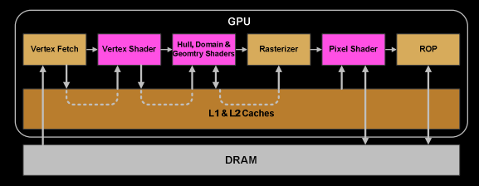
A historical perspective
Embedded Graphics GPUs (and APIs pre-vulkan)
Non-existent communication between different blocks (Blackbox)
Non-existent heterogeneity between CPU and GPU
GPU output → Optimised only for display scanout (exceptions – video streaming ..)
Desktop GPUs (and APIs)
Focused on Higher quality via Programmability
Driven largely by Microsoft DirectX APIs, followed by OpenGL

Slide 7
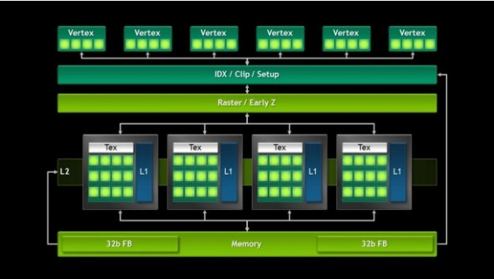
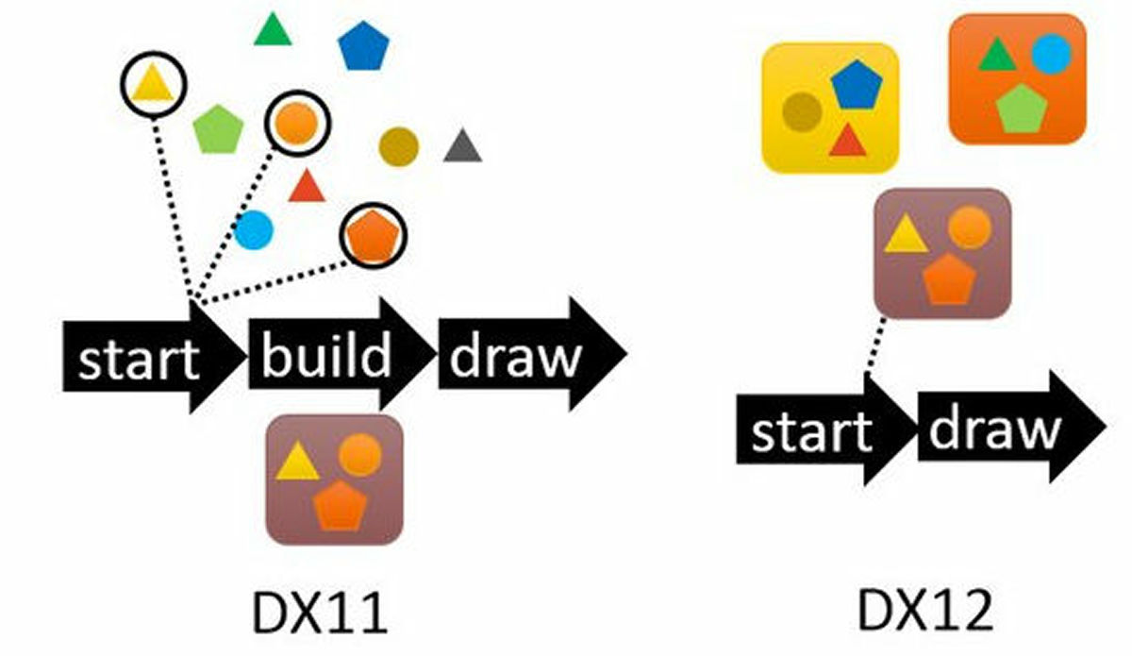
From Pixels to FLOPs
Need for controlling individual blocks, and manage individual contexts better on Desktop APIs, led to more and more programmable cores
Less load on (dynamic) drivers, more (one-time) load on application
Target 0% CPU API overhead, 100% GPU loading

Slide 8
HW architecture advances
Graphics
HDR, HEVC, Data compression
Low-latency pre-emption
Application specific HW units
HDR
Multi-GPU architectures (SLI, ..)
Compute
CUDA core micro-arch
Memory hierarchies
Thread-level pre-emption
Common
GDDR5 advances
Memory controllers, interconnects
Clocks, micro arch
Board designs
Fan/ Thermal designs/ Noise considerations

Slide 9
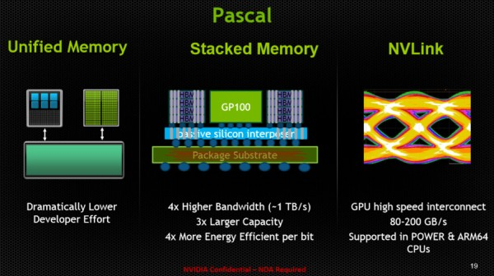
Compute Hardware Advances (continued)

Slide 10
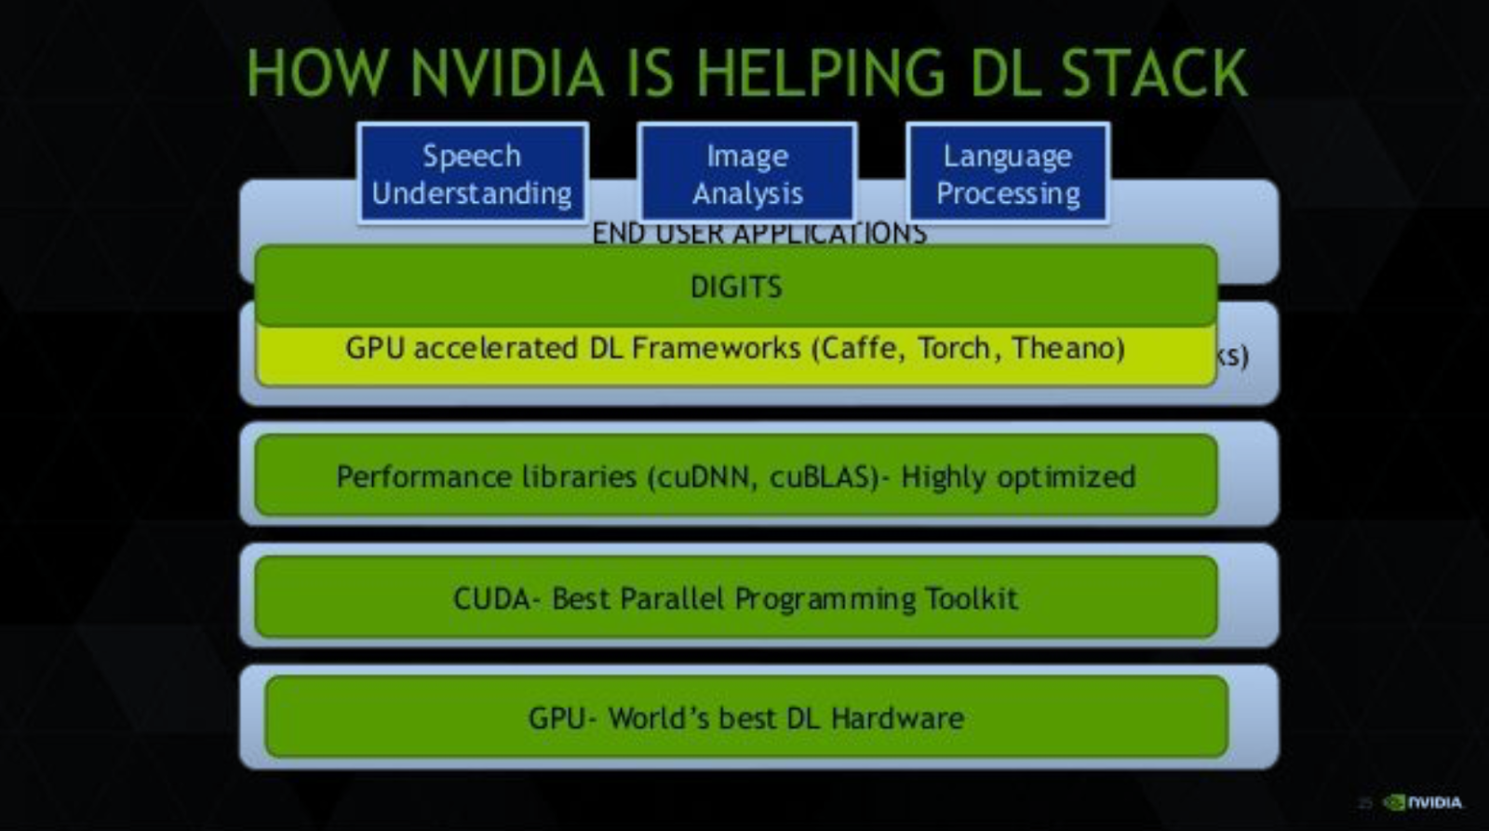

Slide 11
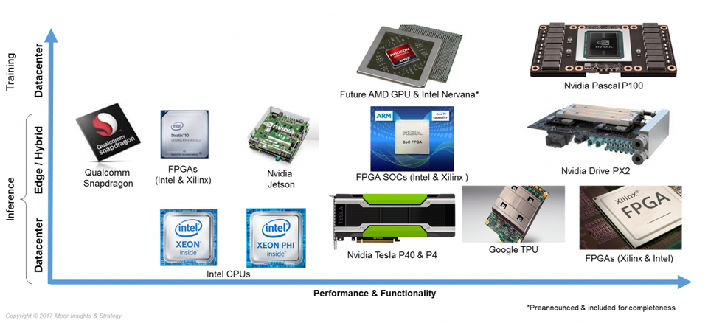
Deep learning Hardware Landscape
https://www.forbes.com/sites/moorinsights/2017/03/03/a-machine-learning-landscape-where-amd-intel-nvidia-qualcomm-and-xilinx-ai-engines-live/#7c1a12fc742f

Slide 12
“.. Understanding C Major took me 27 years …” - Illayaraja, composer
AIVA technologies AI composer, available, today

Slide 13
Programming Models
Languages
CUDA
Native language acceleration
Numba
C++ AMP
New on the GPU
Branching !
Exceptions !

Slide 14
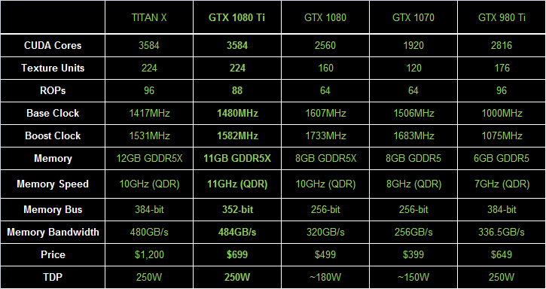
High level comparison

Slide 15
Power performance
Nvidia power/performance

Slide 16
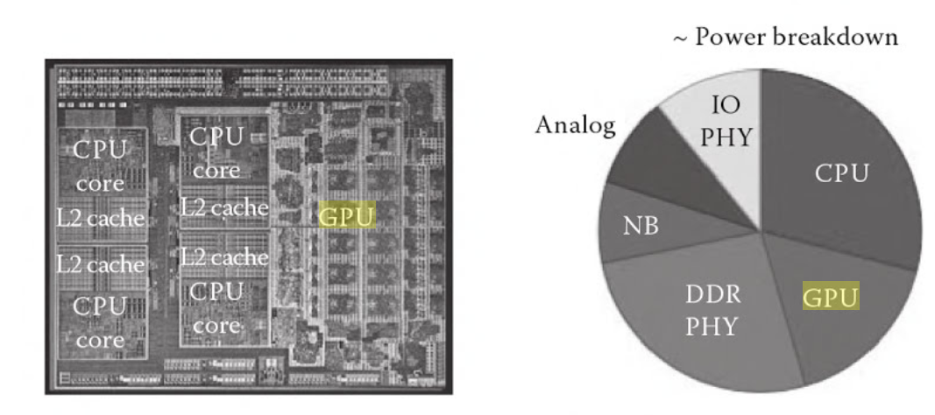
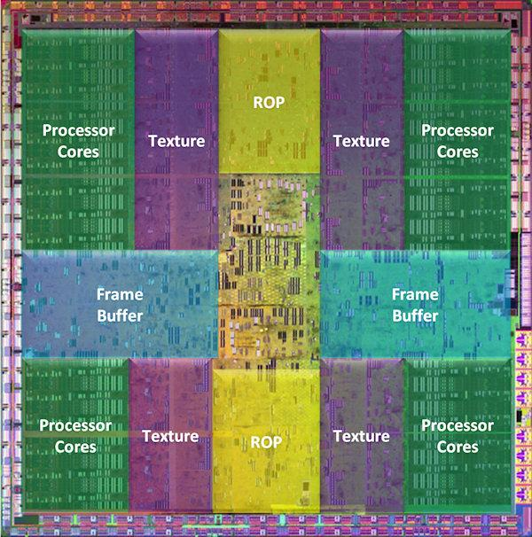
Power and Area
Integrated chipsets
AMD llano 32nm
Discrete Nvidia GPU Area

Slide 17
Quick introduction to GPU Programming

Slide 18
Organisation of the code
Main.cpp
main()
Timing measurement code (cudaEvent*..)
CUDA Acceleration code - Kernel.cu
Kernel wrappers
CudaMem allocations
Grid/block calculations
Kernel calls
Actual kernel

Slide 19
Moving an algorithm to GPU – Tips
C++ file or .cu file ?
'cudaEvent_t': undeclared identifier
Include cuda_runtime.h, not just cuda.h
Dreaded - “0x4 unspecified launch failure”
cudaOccupancyMaxPotentialBlockSize
GridSize
BlockSize
Tool for memory bug-checks
cuda-memcheck.exe
%PROGFILES%\NVIDIA GPU Computing Toolkit\CUDA\vx.y\bin
========= Invalid __global__ write of size 4
========= at 0x000006b0 in ….
CUDA errors can be resident so be aware of the API behaviour
Errors reported by some APIs ex cudaThreadSynchronize() are previous errors !
1D large arrays (ex 1M entries) have issues
Move to 2D
Each kernel composed of “a Grid of Blocks of Threads”

Slide 20
Specifying shared memory
Static
Declared in kernel
Dynamic shared memory allocation
The shared memory allocation size per thread block must be specified (in bytes) using an optional third execution configuration parameter in the kernel call
myKernel <<<grids,blocks, memsizeBytes>>>();
How to synchronise shared memory accesses across threads ?
__syncthreads() in the kernel

Slide 21
GPU Profiling
CudaStreamCreate – Startup several seconds
General DNNs – more Host to Device, than Device to Host
Yolov3 analysis:
23% in add-bias
16% in shortcut
15% in normalize
12% in fill
C:\Program Files\NVIDIA GPU Computing Toolkit\CUDA\v9.1\libnvvp
Using CUDNN for batch-norm reduces this time by about 20%
After profiling:
Moved BatchNorm to CUDNN results in 50% reduction
27% shortcut kernel
19% fill kernel
13% activate array
13% copy

Slide 22
Improving performance
3 fundamental steps
Profile
Profile
Profile
Bottlenecks ?
Read data
Write data
Compute
Avoid stalls - utilize internal memory judiciously
Memory transfer and computation should be done in parallel
Increase utilization – Occupancy
Utilise helper APIs “cudaOccupancyMaxPotentialBlockSize”

Slide 23
CUDA and CUDNN
CUDNN is a library of functions, built using the CUDA API
Focused on Neural networks
Downloaded separately from CUDA kit
What performance improvement does it bring ?
Yolo with different options

Slide 24
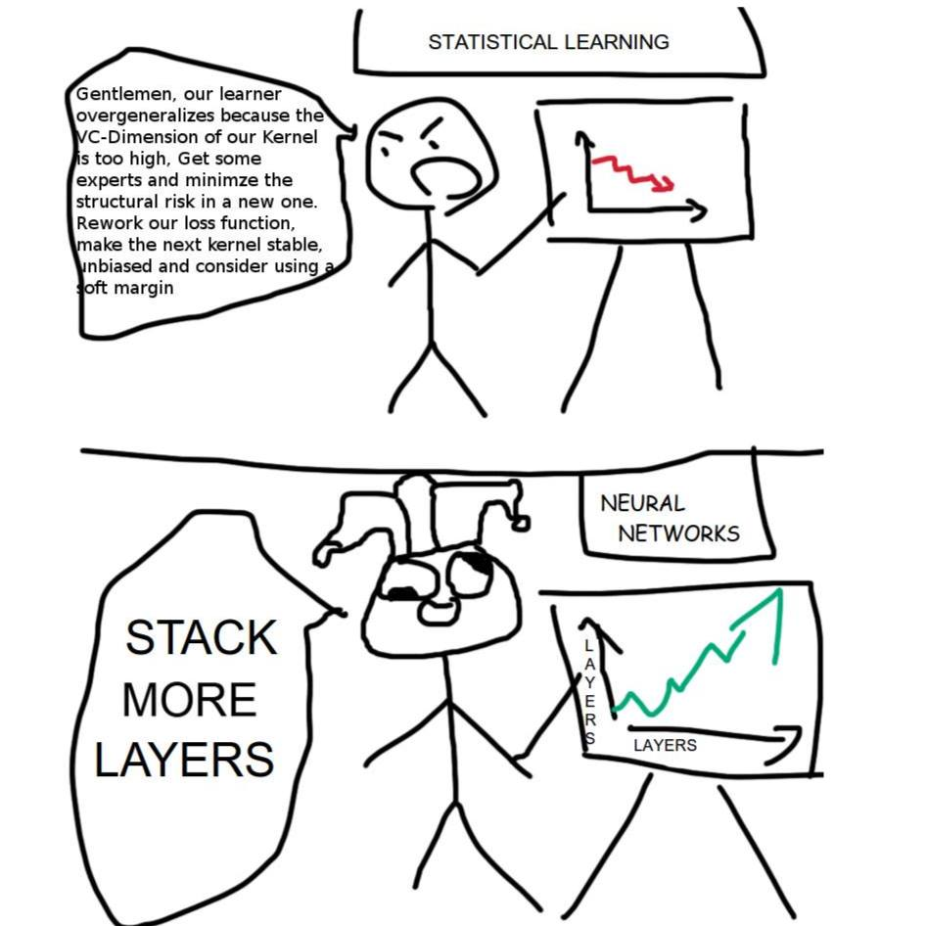
Yolo – with different options (Tegra TK1)
CPU | 39
CUDA | 0.53
CUDNN | 0.01

Slide 25
Algorithms on GPU

Slide 26
Data exploration
4 free parameters – Can model an elephant
http://neuralnetworksanddeeplearning.com/chap3.html#overfitting_and_regularization

Slide 27
Medicine – Drug discovery
AtomNet - structure-based, deep convolutional neural network designed to predict the bioactivity of small molecules for drug discovery applications. (Atomwise company)
apply the convolutional concepts of feature locality and hierarchical composition to the modeling of bioactivity and chemical interactions

Slide 28
Segmentation – Ex Tumors in Pancrea images
Small organ segmentation
Recurrent Saliency Transformation Network. The key innovation is a saliency transformation module, which repeatedly converts the segmentation probability map from the previous iteration as spatial weights and applies these weights to the current iteration

Slide 29
Challenges – Availability of training data
Significant challenge in object detection
Why ?
Solution - Synthetic data
Image augmentation
Lighting, transformations, transparency
euclidaug
Ray tracing
Completely under our control

Slide 30
Challenges - Latency of Algorithms on GPU
How to profile ? What tools ?
Typical Graphics latencies
VR example, framebuffer, display relation
Compute - Average inference latency of Inception v2 with TF 1.5
33ms with batch size of 1
540ms with batch size of 32
“GPU Scheduling on the NVIDIA TX2: Hidden Details Revealed”

Slide 31
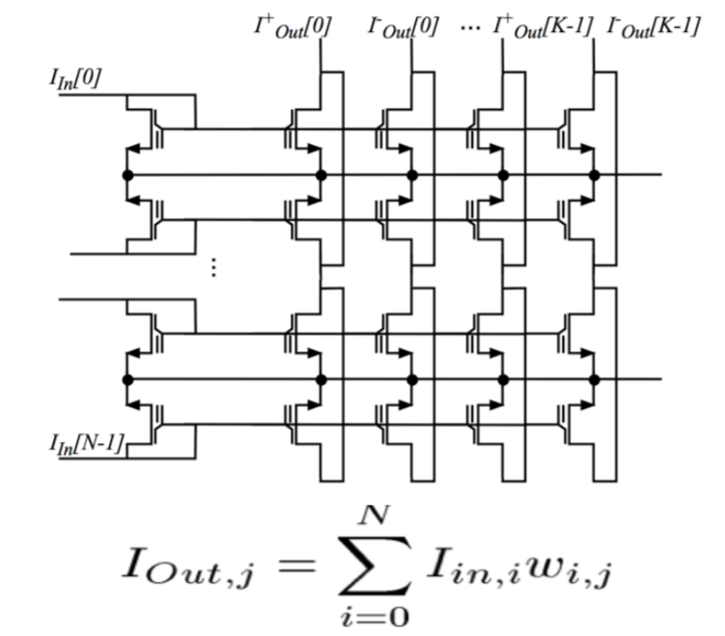
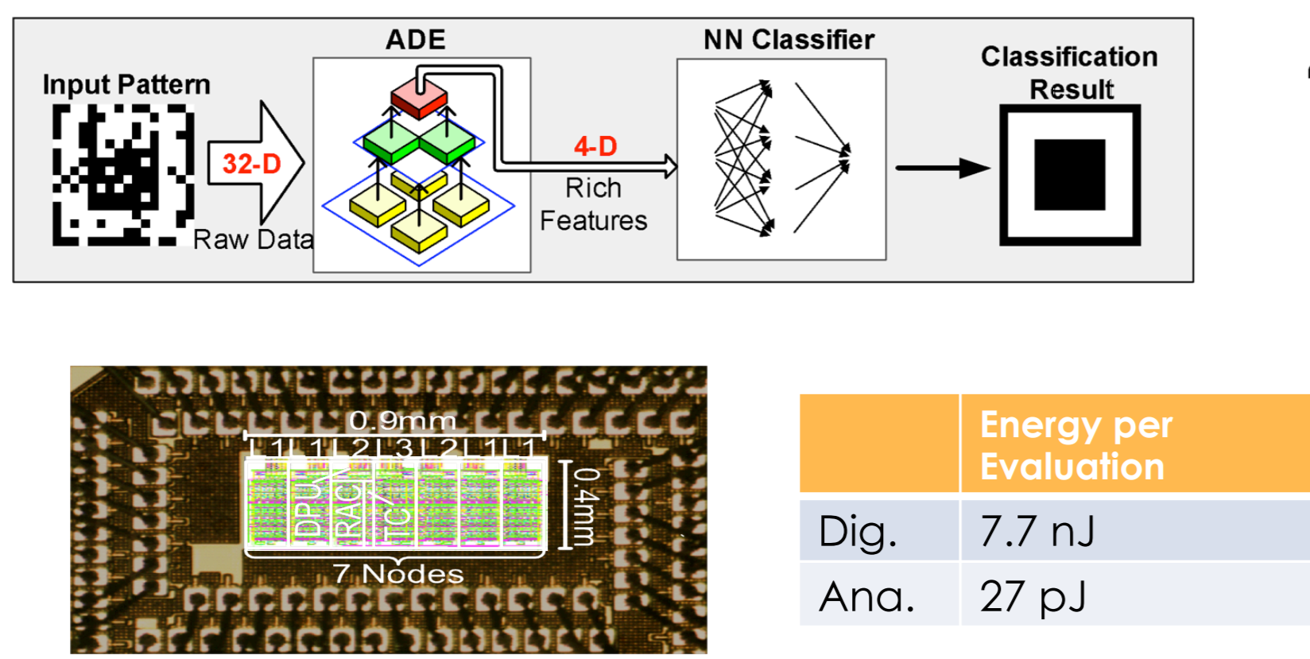
Emerging – Compute-In-Flash
Syntiant, Mythic Analog NN Implementation on Flash
http://www.calit2.uci.edu/uploads/Media/Text/HOLLEMAN.pdf

Slide 32
Emerging – DL and Operating Systems
Windows
Linaro

Slide 33

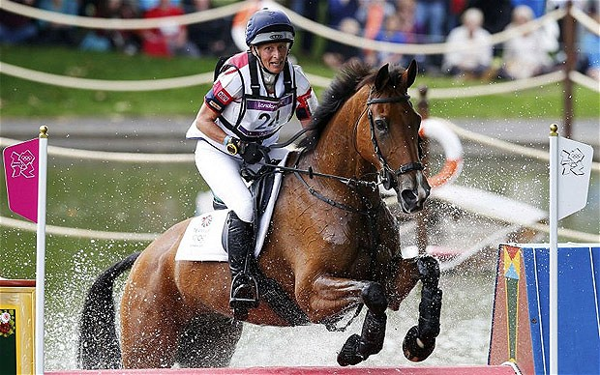

Intelligence is not a single thing
A group of intelligences working together
Attention, reasoning, processing speed, movement
Information and Intelligence not always visual !!

Slide 34
Conclusion
Religion and Spirituality
Future trends
“near-chip-memory”
Better atomics
Process technologies
Truly heterogenous multi-core architectures

Slide 35
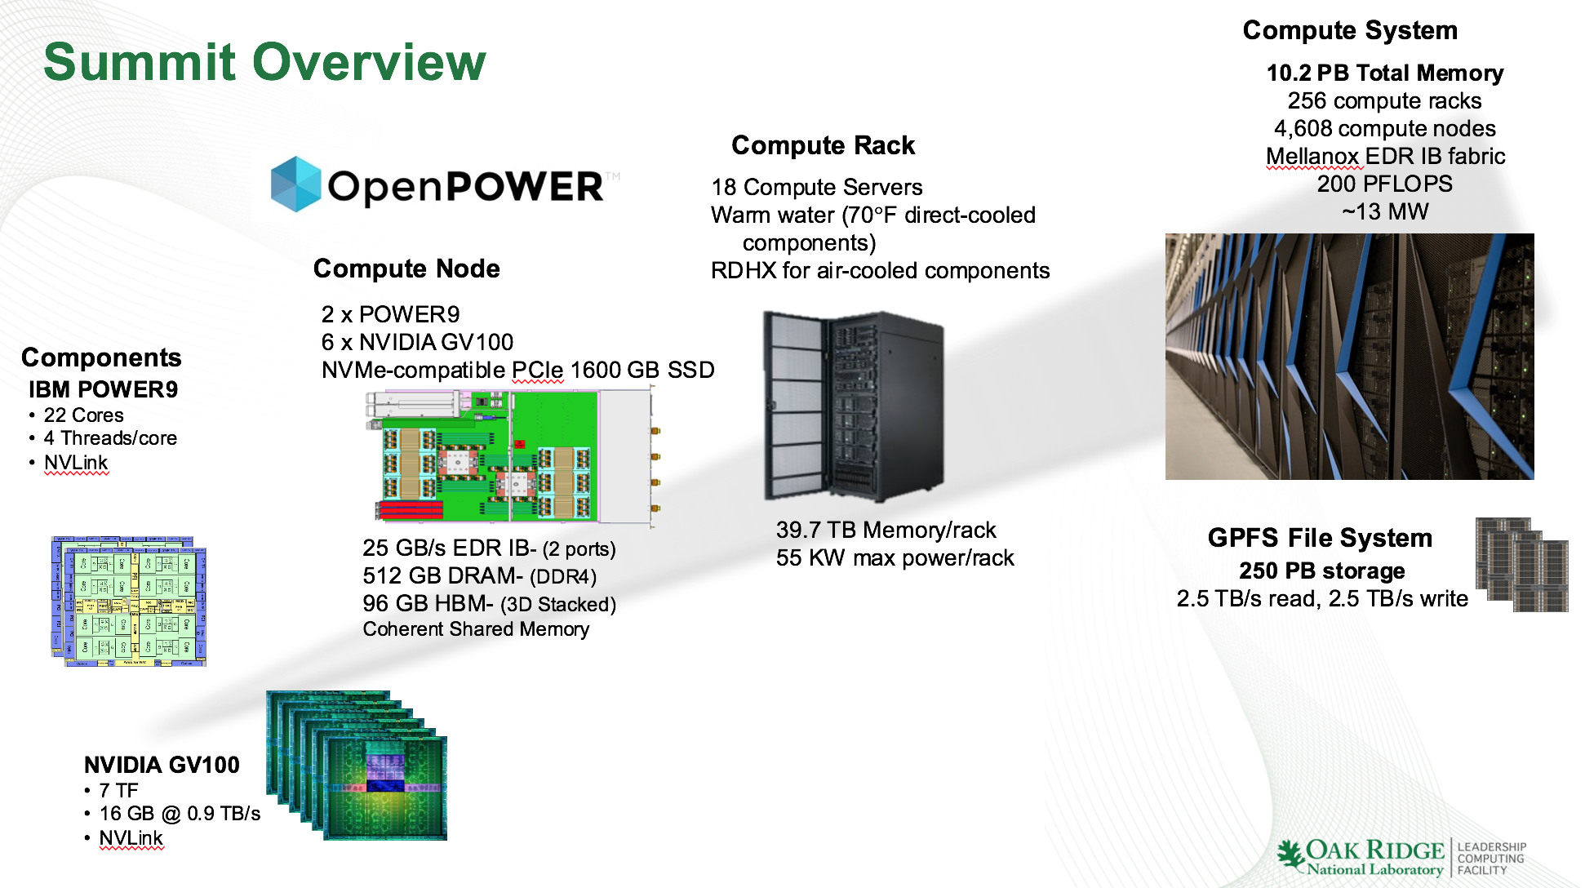
From IBM

Slide 36
Netscope
http://ethereon.github.io/netscope/quickstart.html
Tool for visualizing neural network architectures (or technically, any directed acyclic graph). It currently supports Caffe's prototxt format.

Slide 37
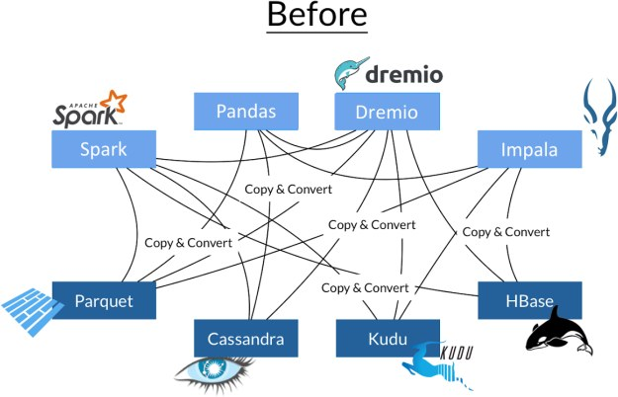
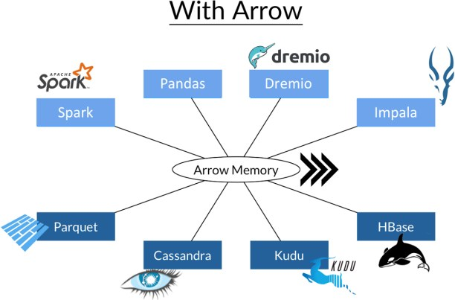
Arrow - GDF

Slide 38
Visualisation H20 – from VW talk on analytics
https://www.youtube.com/watch?v=-mBg-lFz5fQ
VW – Use GPU for both – analysis+queries

Slide 39
What are we creating AI for ?
Intelligence on earth
Intelligence outside earth
Space travel under 0-gravity
Cardiovascular deterioration
Decalcification
Demineralisation of bones
Muscular fitness
Demineralisation recovery time high, perhaps not recoverable
Reconaissance missions

